Slide 1
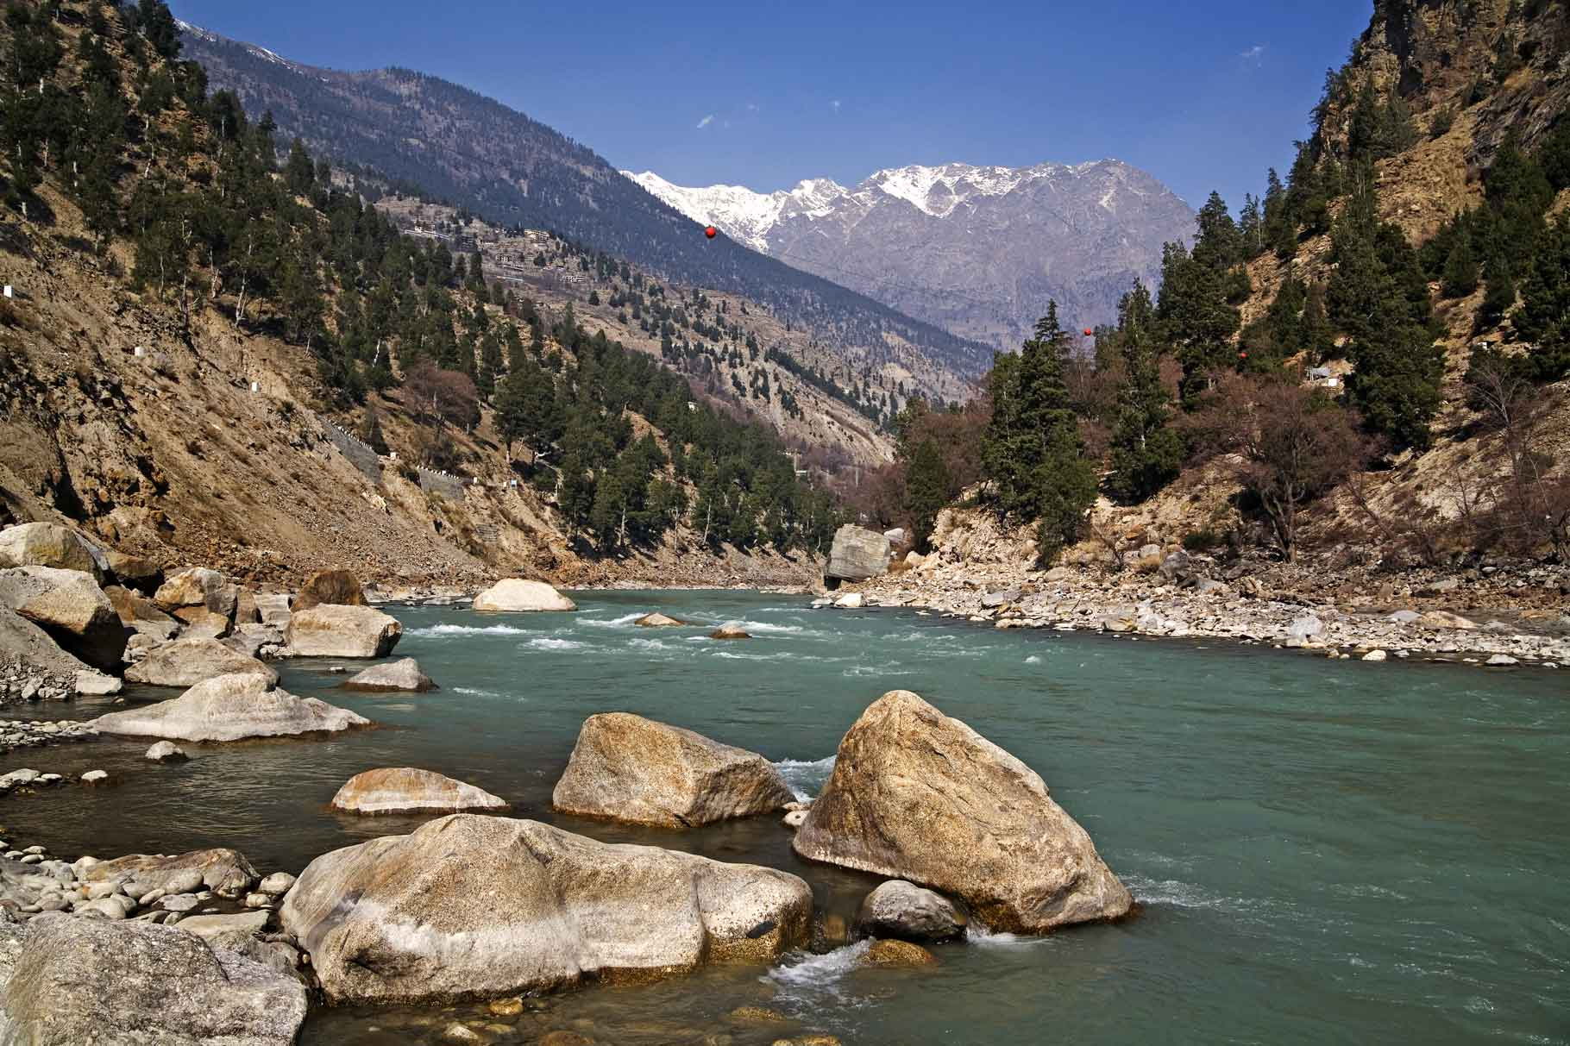
NATIONAL HYDROLOGY PROJECT
BHAKRA BEAS MANAGEMENT BOARD

Slide 2
BHAKRA BEAS MANAGEMENT BOARD (CENTRAL I.A.) SPMU
Bhakra Beas
Nation’s Pride
Management
Coordinator | Chairman, BBMB
Technical Wing
Nodal Officer | Director/NHP
Additional Superintending Engineer/ XEN | 2 Nos.
Assistant Design Engineer/SDO | 4 Nos.
Junior Engineer | 1 No.
Supporting Staff | 7 Nos.
Finance Wing
Accounts Officer | 1 No.
Supporting Staff | 3 No.
Management
Coordinator - Chairman, BBMB
Technical Wing
Director, NHP-Nodal Officer
Addl. S.E.-2 Nos.
Assistant Design Engineers-4 nos.
Junior Engineer-1 No.
Supporting Staff-8 No.
Finance Wing
Accounts Officer, NHP

Slide 3
Funds Received for 2016-2017 & 2017-2018
NATIONAL HYDROLOGY PROJECT
Bhakra Beas
Nation’s Pride
Year | Funds Received | Expenditure incurred
2016-2017 | 22,50,000 | 16,14,212
2017-2018 | 1,49,00,000 | 2,44,122

Slide 4
Major Procurement Item in PIP
NATIONAL HYDROLOGY PROJECT
Bhakra Beas
Nation’s Pride
Item Code | Package Name | Package Cost (Rs. in Lacs)
A1.1.01 & A1.1.02 | RTDAS (Telemetry and civil works) | 640
A1.9.03 | O&M of Hydro-met System-Communication | 150
D1.1.01 & A1.9.02 | Construction of DATA Centre & Furnishing | 200 150
B2.1.02 | Strengthening and Integration with India-WRIS | 100
C1.1.01 | Consultancy Services for extension of RTDSS | 450
C1.1.02 | Sedimentation Study | 400
C1.1.04 | River Basin Information System | 125
C1.1.05 | O&M of Existing System | 150

Slide 5
Major Procurement in AWP 2016-2017
NATIONAL HYDROLOGY PROJECT
Bhakra Beas
Nation’s Pride
Item Code | Package Name | Package Cost in Lacs | Status
D3.2.02 | Renovation of NHP Directorate | 3 | To be done in 2017-18
D3.2.03 | Procurement of Inspection Vehicle | 8 | Completed
D3.2.04 | Procurement of Laptop with accessories | 5 | 3 Laptops Purchased out of 8 No.

Slide 6
Major Procurement in AWP 2017-2018
NATIONAL HYDROLOGY PROJECT
Bhakra Beas
Nation’s Pride
Item Code | Package Name | Package Cost (Rs.in Lacs)
A1.1.01.01 & A1.1.02.01 | Procurement of Real Time Hydro-meteorological Sensors | 70
C1.1.01.01 | O&M of RTDSS | 50
D1.1.01.01 | Construction of DATA Training Centre | 100
D3.2.01.06 | Renovation of NHP Directorate | 6
A1.9.01.01 | AMC of DAS System | 120
D3.2.01.06 | Procurement of Articulating Pick up Vehicle (Multi-utility) | 12

Slide 7
Physical Progress
NATIONAL HYDROLOGY PROJECT
Bhakra Beas
Nation’s Pride
Package Name | Physical Progress
Procurement of Real Time Hydro-meteorological Sensors | Process underway
O&M of RTDSS | Process underway
Construction of DATA Training Centre | Process underway
Renovation of NHP Directorate | Process underway
AMC of DAS System | Process underway
Procurement of Articulating Pick up Vehicle (Multi-utility) | proposed

Slide 8
Status of Bid Document
NATIONAL HYDROLOGY PROJECT
Bhakra Beas
Nation’s Pride
Package Name | Status
Procurement of Real Time Hydro-Meteorological Sensors | Under Preparation
O&M of RTDSS | Ready to be Floated
Construction of DATA Training Centre | Under Preparation
Renovation of NHP Directorate | Ready to be Floated
AMC of DAS System | Floated
Procurement of Articulating Pick up Vehicle (Multi-utility) | Under Preparation

Slide 9
Status of various Studies/PDS etc
NATIONAL HYDROLOGY PROJECT
Bhakra Beas
Nation’s Pride
Not in PIP of BBMB

Slide 10
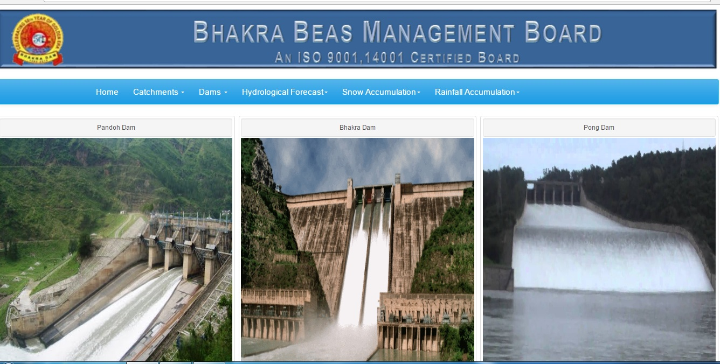
Status of Data Entry in E-SWIS & State WRIS
NATIONAL HYDROLOGY PROJECT
Bhakra Beas
Nation’s Pride
Database Ready and updated in Real time basis available on 210.212.64.190/BBMB

Slide 11
Status of Hydro-met stations
NATIONAL HYDROLOGY PROJECT
Bhakra Beas
Nation’s Pride
Stations Installed under HP-II |  | Number
Weather Monitoring | Snow, Rain & Full Climatic Stations | 37
Discharge Monitoring | Rivers | 27
 | Dams / Barrages | 15
 | Canals | 17
Total |  | 96
Stations Proposed and Submitted to CWC under NHP |  | Number
Weather Monitoring | Snow, Rain & Full Climatic Stations | 21
Discharge Monitoring | Canals | 10
Total |  | 31

Slide 12
Status of Public Finance Management System (PFMS)
NATIONAL HYDROLOGY PROJECT
Bhakra Beas
Nation’s Pride
Preference is being given to Government e-market portal i.e. www.gem.gov.in

Slide 13
Instrumentation (Item Code A1.1)
Finalisation of Station (31.8.2017)
Site Selection & Preparation of Specs (16.9.2017)
Preparation of Bid Document (30.9.2017)
Processing of Bid Document (31.10.2017)
Floating of NIT (7.11.2017)
Opening of NIT (28.11.2017)
Issue of Work Order (29.12.2017)
Completion of Work (29.12.2018)

Slide 14
O&M of RTDSS (Item Code C1.1)
Preparation of Bid Document (NCB) Done
Processing Bid Document (30.8.2017)
Floating of NIT (7.9.2017)
Opening of NIT (7.10.2017)
Issue of Work Order (31.10.2017)
Completion of Work (31.10.2018)

Slide 15
Construction of Data Training Centre (Item Code D1.1)
Finalisation of site (Done)
Approval from UT Chandigarh (16.9.2017)
Preparation of Document for architect (22.9.2017)
Processing of Document for architect (10.10.2017)
Architect Finalisation (30.10.2017)
Building Plan Finalisation (30.11.2017)
Building Plan Approval from UT Chandigarh (30.12.2017)
Preparation of Bid Document (NCB) (7.1.2018)
Processing Bid Document (31.1.2018)
Floating of NIT (7.2.2018)
Opening of NIT (28.2.2018)
Issue of Work Order (28.3.2018)
Completion of Work (28.3.2019)

Slide 16
Renovation of NHP Directorate (Item Code D3.2)
Preparation of Bid Document Limited Tender (Done)
Floating of NIT (7.9.2017)
Opening of NIT (7.10.2017)
Issue of Work Order (30.10.2017)
Completion of Work (30.12.2017)
Processing Bid Document (30.8.2017)

Slide 17
Procurement of Articulating Pick Up Vehicle (Item Code D3.2)
Preparation of Specs (7.9.2017)
Preparation of Bid Document (20.9.2017)
Floating of NIT (7.11.2017)
Opening of NIT (28.11.2017)
Issue of Work Order (30.12.2017)
Completion of Work (28.3.2018)
Processing Bid Document (30.10.2017)

Slide 18
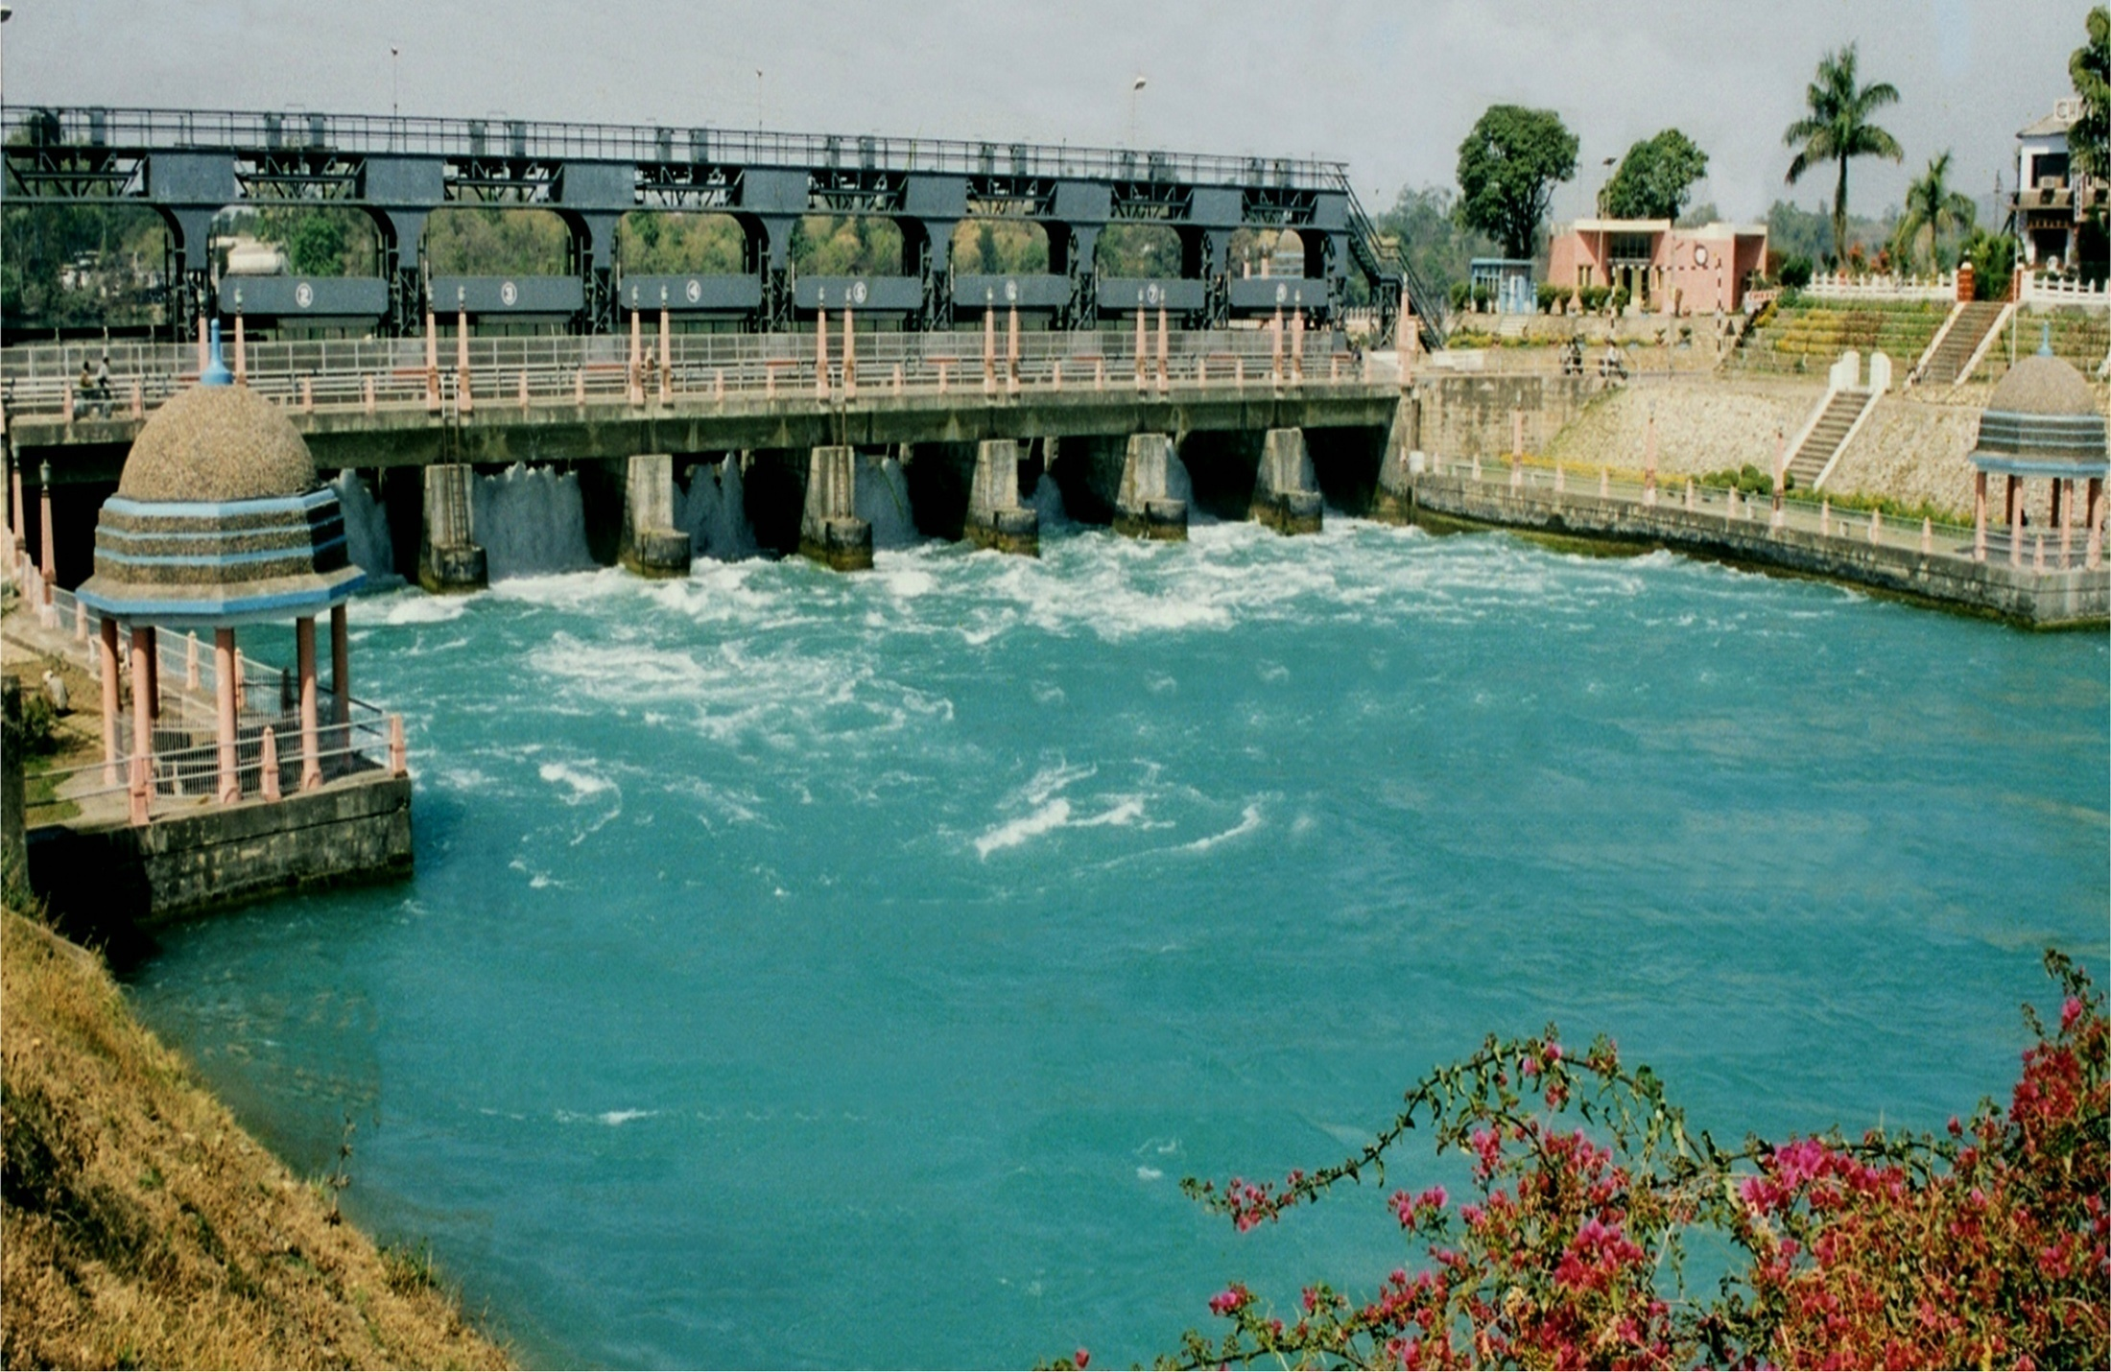
NATIONAL HYDROLOGY PROJECT
Bhakra Beas
Nation’s Pride
Thanks

